Slide 1
Chapter 2
Algorithm Discovery and Design

Slide 2
Learning Objectives (1 of 2)
Explain the benefits of pseudocode over natural language or a programming language
Represent algorithms using pseudocode
Identify algorithm statements as sequential, conditional, or iterative
Define abstraction and top-down design, and explain their use in breaking down complex problems

Slide 3
Learning Objectives (2 of 2)
Illustrate the operation of algorithms for:
Multiplication by repeated addition
Sequential search of a collection of values
Finding the maximum element in a collection
Finding a pattern string in a larger piece of text

Slide 4
Introduction
Everyday algorithms, such as hair washing, may not be suitable for computers to perform (as in Chapter 1).
Algorithmic problem solving focuses on algorithms suitable for computers such as searching lists and matching patterns.
Pseudocode is a tool for designing algorithms but does not run on a computing device.
This chapter will use a set of problems to illustrate algorithmic problem solving, including those with conditional statements and loops.

Slide 5
Representing Algorithms (1 of 5)
Natural language is:
Expressive and easy to use
Verbose, unstructured, and ambiguous
Programming languages are:
Structured and designed for computers
Grammatically fussy and cryptic
Pseudocode lies somewhere between these two and is used to design algorithms prior to coding them

Slide 6
Representing Algorithms Natural Language (1 of 2)
FIGURE 2.1
Initially, set the value of the variable carry to 0 and the value of the variable i to 0. When these initializations have been completed, begin looping as long as the value of the variable i is less than or equal to (m - 1). First, add together the values of the two digits a_{i} and b_{i} and the current value of the carry digit to get the result called c_{i} Now check the value of c_{i} to see whether it is greater than or equal to 10. If c_{i} is greater than or equal to 10, then reset the value of carry to 1 and reduce the value of c_{i} by 10; otherwise, set the value of carry to 0. When you are

Slide 7
Representing Algorithms Natural Language (2 of 2)
finished with that operation, add 1 to i and begin the loop all over again. When the loop has completed execution, set the leftmost digit of the result c_{m} to the value of carry and print out the final result, which consists of the digits c_{m} c_{m-1…}c₀. After printing the result, the algorithm is finished, and it terminates.
The addition algorithm of Figure 1.2 expressed in natural language

Slide 8
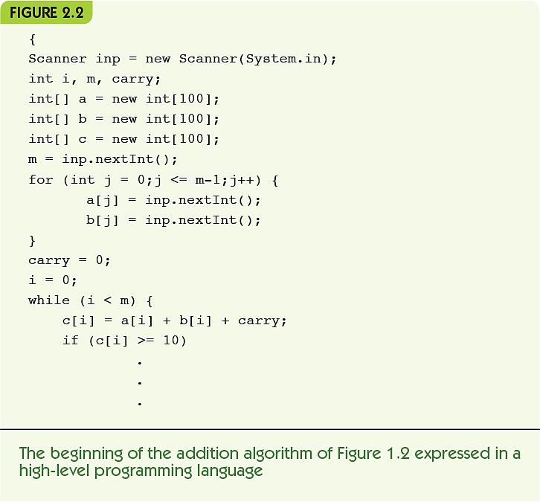
Representing Algorithms Programming Language

Slide 9
Representing Algorithms (2 of 5)
Sequential operations perform a single task
The three basic sequential operations:
Computation: a single numeric calculation
Input: gets data values from outside the algorithm
Output: sends data values to the outside world
A sequential algorithm is made up only of sequential operations
A variable is a named storage location to hold a data value
Example: computing average miles per gallon

Slide 10
Representing Algorithms Sequential Algorithm
FIGURE 2.3
Step | Operation
1 | Get values for gallons used, starting mileage, ending mileage
2 | Set value of distance driven to (ending mileage - starting mileage)
3 | Set value of average miles per gallon to (distance driven ÷ gallons used)
4 | Print the value of average miles per gallon
5 | Stop
Algorithm for computing average miles per gallon (version 1)

Slide 11
Representing Algorithms (3 of 5)
Control operation: changes the normal flow of control
Conditional statement: asks a question and selects among alternative options:
Evaluate the true/false condition
If the condition is true, then do the first set of operations and skip the second set
If the condition is false, skip the first set of operations and do the second set
Example: check for good or bad gas mileage

Slide 12
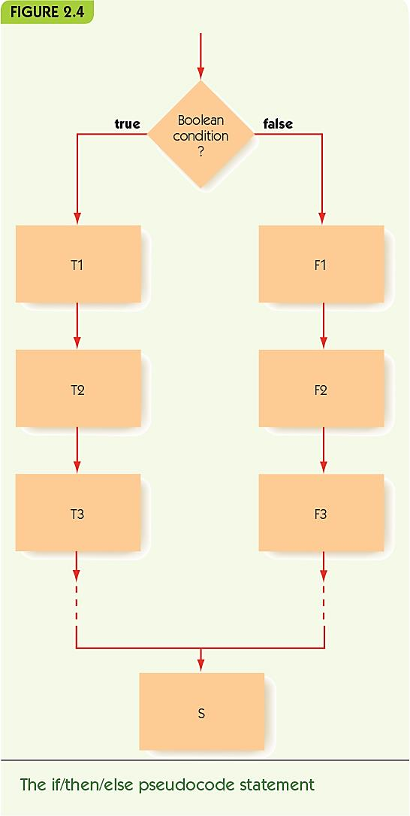
Representing Algorithms Conditional Statement (1 of 2)

Slide 13
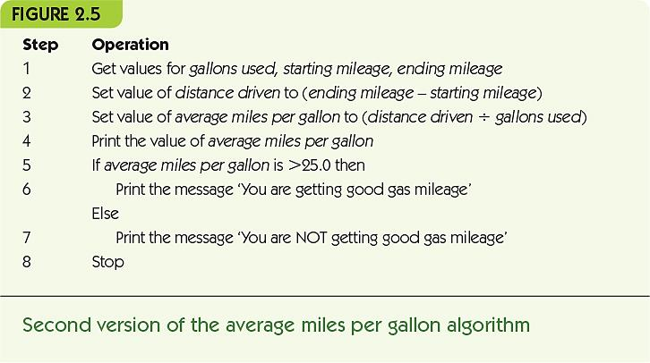
Representing Algorithms Conditional Statement (2 of 2)

Slide 14
Representing Algorithms (4 of 5)
Iteration: an operation that causes looping, repeating a block of instructions
While statement repeats while a condition remains true
Continuation condition: a test to see if while loop should continue
Loop body: instructions to perform repeatedly
Example: repeated mileage calculations

Slide 15
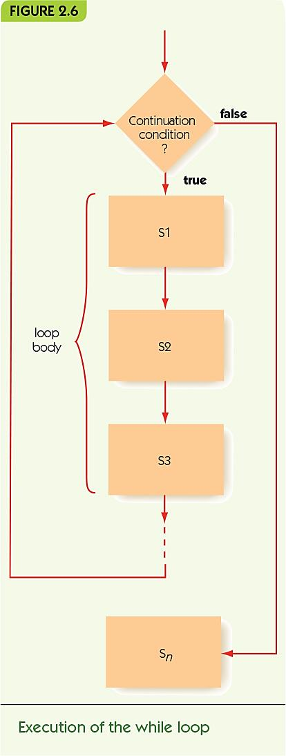
Representing Algorithms Iteration and Loop Body (1 of 2)

Slide 16
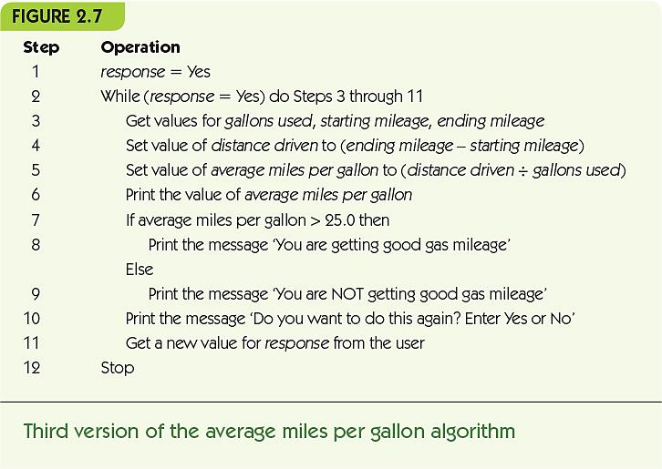
Representing Algorithms Iteration and Loop Body (2 of 2)

Slide 17
Representing Algorithms (5 of 5)
Do/while, alternate iterative operation
Continuation condition appears at the end
Loop body always performed at least once
Primitive operations: sequential, conditional, and iterative are all that is needed

Slide 18
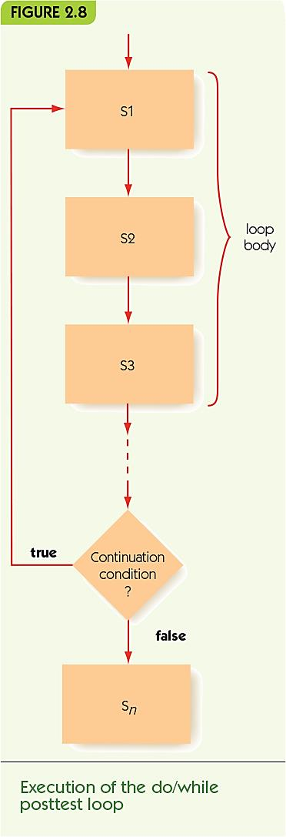
Representing Algorithms Do/While Posttest Loop (1 of 2)

Slide 19
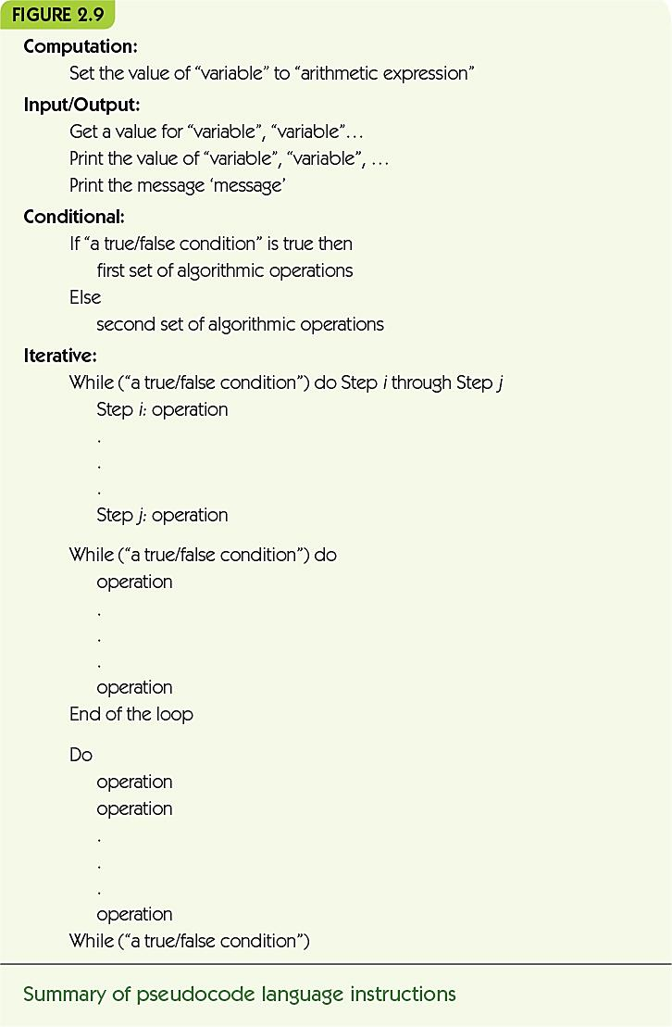
Representing Algorithms Do/While Posttest Loop (2 of 2)

Slide 20
Examples of Algorithmic Problem Solving Example 1: Go Forth and Multiply (1 of 5)
Given two nonnegative integer values, a ≥ 0, b ≥ 0, compute and output the product (a × b) using the technique of repeated addition. That is, determine the value of the sum a + a + a + … + a (b times).

Slide 21
Examples of Algorithmic Problem Solving Example 1: Go Forth and Multiply (2 of 5)
Get input values
Get values for a and b
Compute the answer
Loop b times, adding each time*
Output the result
Print the final value*
* steps need elaboration

Slide 22
Examples of Algorithmic Problem Solving Example 1: Go Forth and Multiply (3 of 5)
Loop b times, adding each time
Get values for a and b
Set the value of count to 0
While (count < b) do
… the rest of the loop*
Set the value of count to (count + 1)
End of the loop
* steps need elaboration

Slide 23
Examples of Algorithmic Problem Solving Example 1: Go Forth and Multiply (4 of 5)
Loop b times, adding each time
Get values for a and b
Set the value of count to 0
Set the value of product to 0
While (count < b) do
Set the value of product to (product + a)
Set the value of count to (count + 1)
End of the loop
Output the result
Print the value of product

Slide 24
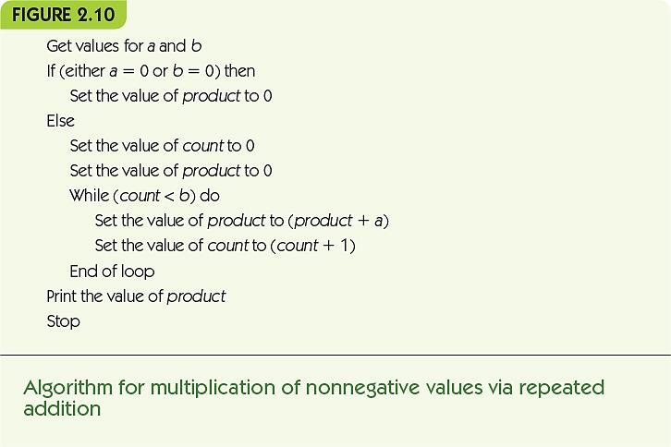
Examples of Algorithmic Problem Solving Example 1: Go Forth and Multiply (5 of 5)

Slide 25
Examples of Algorithmic Problem Solving Example 2: Looking, Looking, Looking (1 of 5)
Assume that we have a list of 10,000 names that we define as N₁, N₂, N₃, … , N_{10,000}, along with the 10,000 telephone numbers of those individuals, denoted as T₁, T₂, T₃, … , T_{10,000}. To simplify the problem, we initially assume that all names in the book are unique and that the names need not be in alphabetical order.

Slide 26
Examples of Algorithmic Problem Solving Example 2: Looking, Looking, Looking (2 of 5)
Three versions here illustrate algorithm discovery, working toward a correct, efficient solution:
A sequential algorithm (no loops or conditionals)
An incomplete iterative algorithm
A correct algorithm

Slide 27
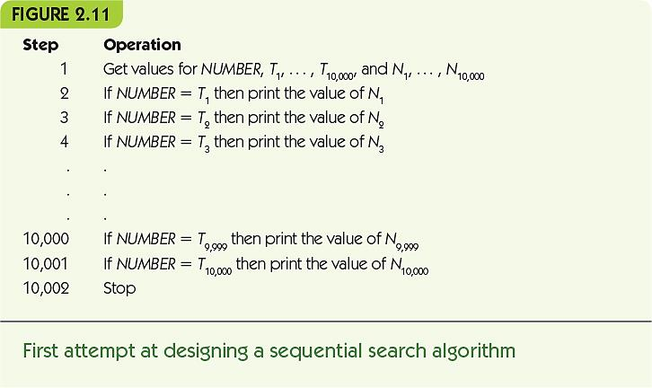
Examples of Algorithmic Problem Solving Example 2: Looking, Looking, Looking (3 of 5)

Slide 28
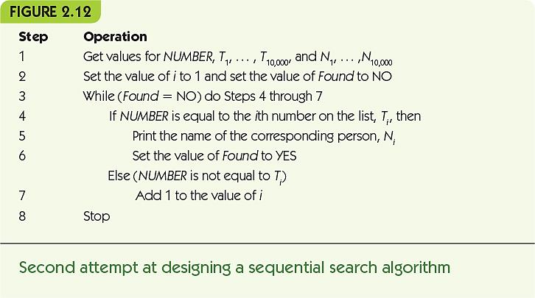
Examples of Algorithmic Problem Solving Example 2: Looking, Looking, Looking (4 of 5)

Slide 29
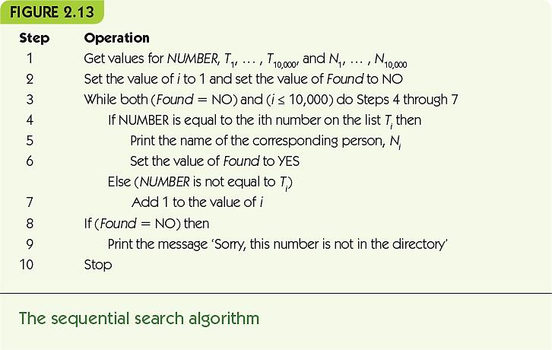
Examples of Algorithmic Problem Solving Example 2: Looking, Looking, Looking (5 of 5)

Slide 30
Examples of Algorithmic Problem Solving Example 3: Big, Bigger, Biggest (1 of 2)
Library: A collection of prewritten, useful algorithms
A “building-block” algorithm used in many libraries:
Given a value n ≥ 1 and a list containing exactly n unique numbers called A₁, A₂, … , A_{n}, find and print out both the largest value in the list and the position in the list where that largest value occurred.

Slide 31
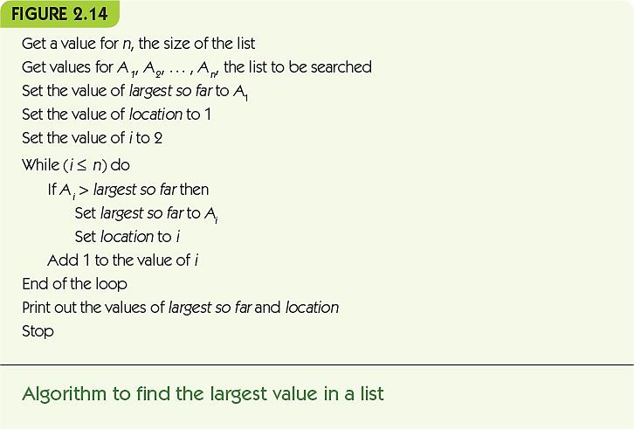
Examples of Algorithmic Problem Solving Example 3: Big, Bigger, Biggest (2 of 2)

Slide 32
Examples of Algorithmic Problem Solving Example 4: Meeting Your Match (1 of 4)
Pattern matching: common across many applications, such as:
Word processor search, web search, image analysis, and human genome project
Let’s formally define the pattern-matching problem as follows:
You will be given some text composed of n characters that will be referred to as T₁ T₂ … T_{n}. You will also be given a pattern of m characters, m ≤ n, that will be represented as P₁ P₂ … P_{m}. The algorithm must locate every occurrence of the given pattern within the text. The output of the algorithm is the location in the text where each match occurred.

Slide 33
Examples of Algorithmic Problem Solving Example 4: Meeting Your Match (2 of 4)
Algorithm has two parts:
Sliding the pattern along the text, aligning it with each position in turn
Given a particular alignment, determine if there is a match at that location
Solve parts separately and use
Abstraction: focus on high level, not details
Top-down design: start with big picture, gradually elaborate parts

Slide 34
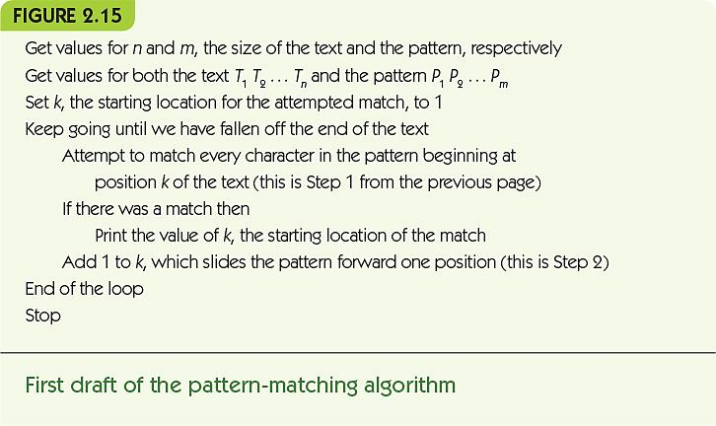
Examples of Algorithmic Problem Solving Example 4: Meeting Your Match (3 of 4)

Slide 35
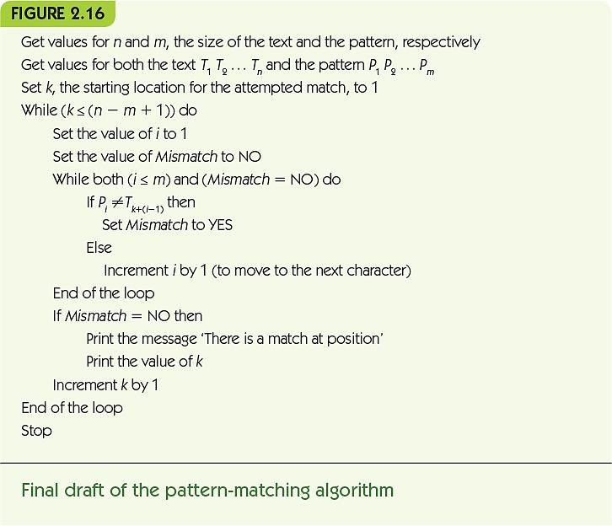
Examples of Algorithmic Problem Solving Example 4: Meeting Your Match (4 of 4)

Slide 36
Summary
Pseudocode is used for algorithm design: structured like code but allows English and mathematical phrasing and notation
Pseudocode is made up of sequential, conditional, and iterative operations
Algorithmic problem solving involves:
Step-by-step development of algorithm pieces
Use of abstraction and top-down design

